Slide 1
NEO4J CYPHER TUTORIAL WITH PYTHON
Set New Node Property By Reading Csv Input Using Cypher ,Apoc & Python
Tutorial 94

Slide 2
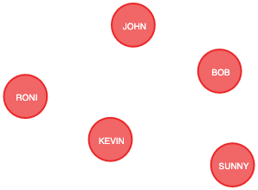
Present State

Slide 3
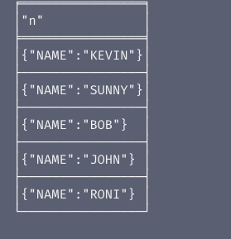
Present properties
Node properties

Slide 4
Sample csv
LABEL,NAME,COURSE
Student,RONI,IT
Student,SUNNY,MANAGEMENT

Slide 5
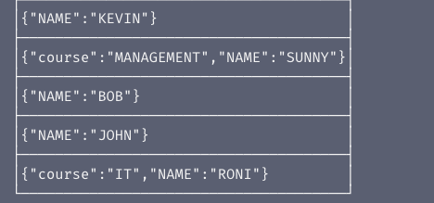
Expected properties

Slide 6
Use case
Set new node properties for neo4j graph from csv input using cypher ,apoc & python

Slide 7
Pre-requisites
apoc.import.file.enabled=true
apoc.import.file.use_neo4j_config=false

Slide 8
Add new property for node from graph using csv input
call apoc.load.csv("file:///users/roni/data/json_data/sample.csv")
yield map
unwind map.COURSE as course
unwind map.LABEL as label
unwind map.NAME as name
match(a{NAME:name})
unwind labels(a) as type
with a,type,label,course
where type=label
set a.COURSE=course
return a
Code written in neo4j browser

Slide 9
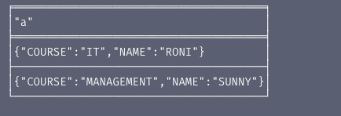
output
From neo4j browser

Slide 10
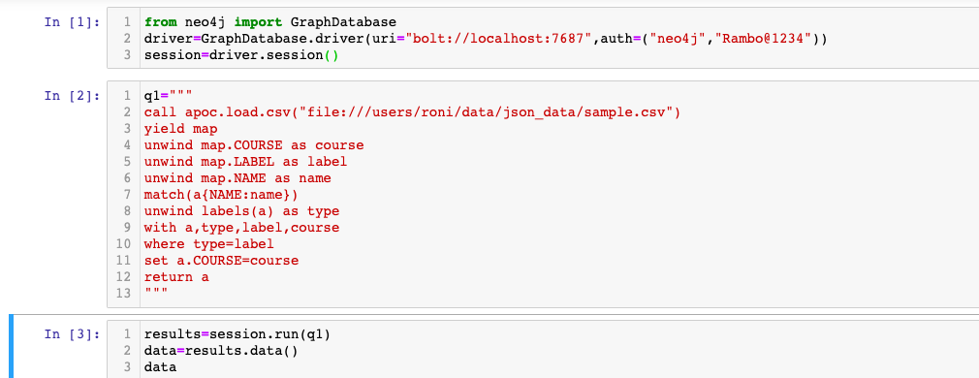
Add new property for node from graph using csv input
Code written in python ide

Slide 11

output
From python ide

